Slide 1
Fracture mandible; the art to manage

Slide 2
History
Edwin Smith Papyrus 1650 described Hx, Phy, Diagnosis. Often fatal disease
Hippocrates – Described monomaxillary dental fixation and binding

Slide 3
History
Schede 1888 – Bone plate of steel secured with 4 screws
Luhr 1960 – Developed mandibular compression plates
Michelet and Champy 1970’s

Slide 4
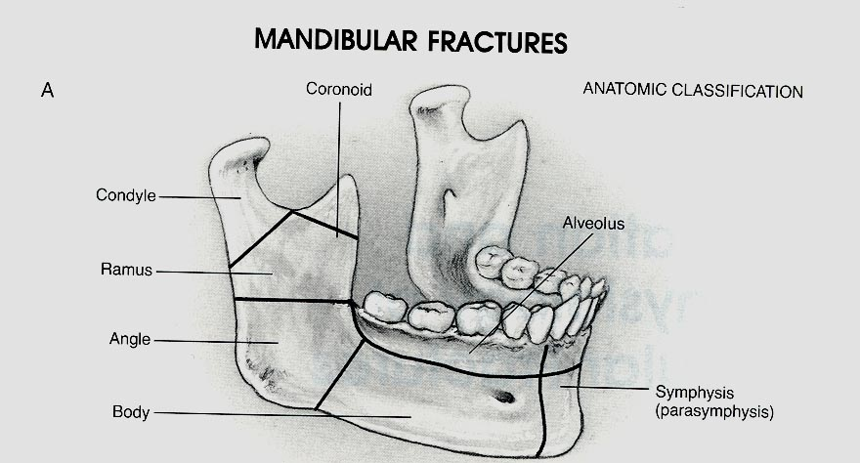

Slide 6
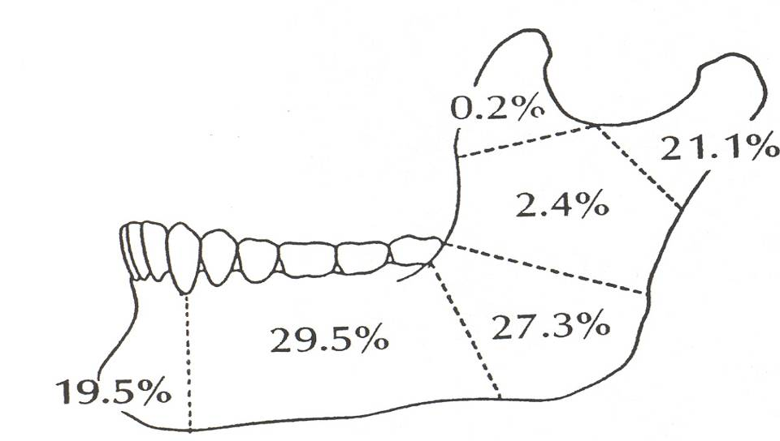

Slide 7
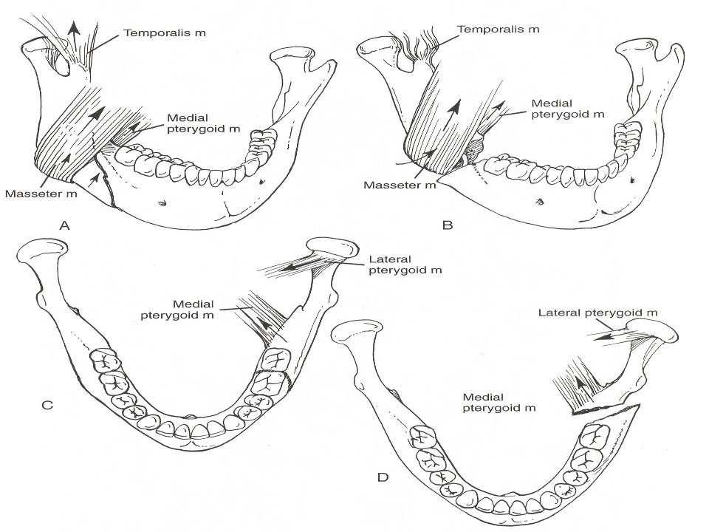

Slide 9
Symphyseal and parasymphyseal fractures

Slide 10
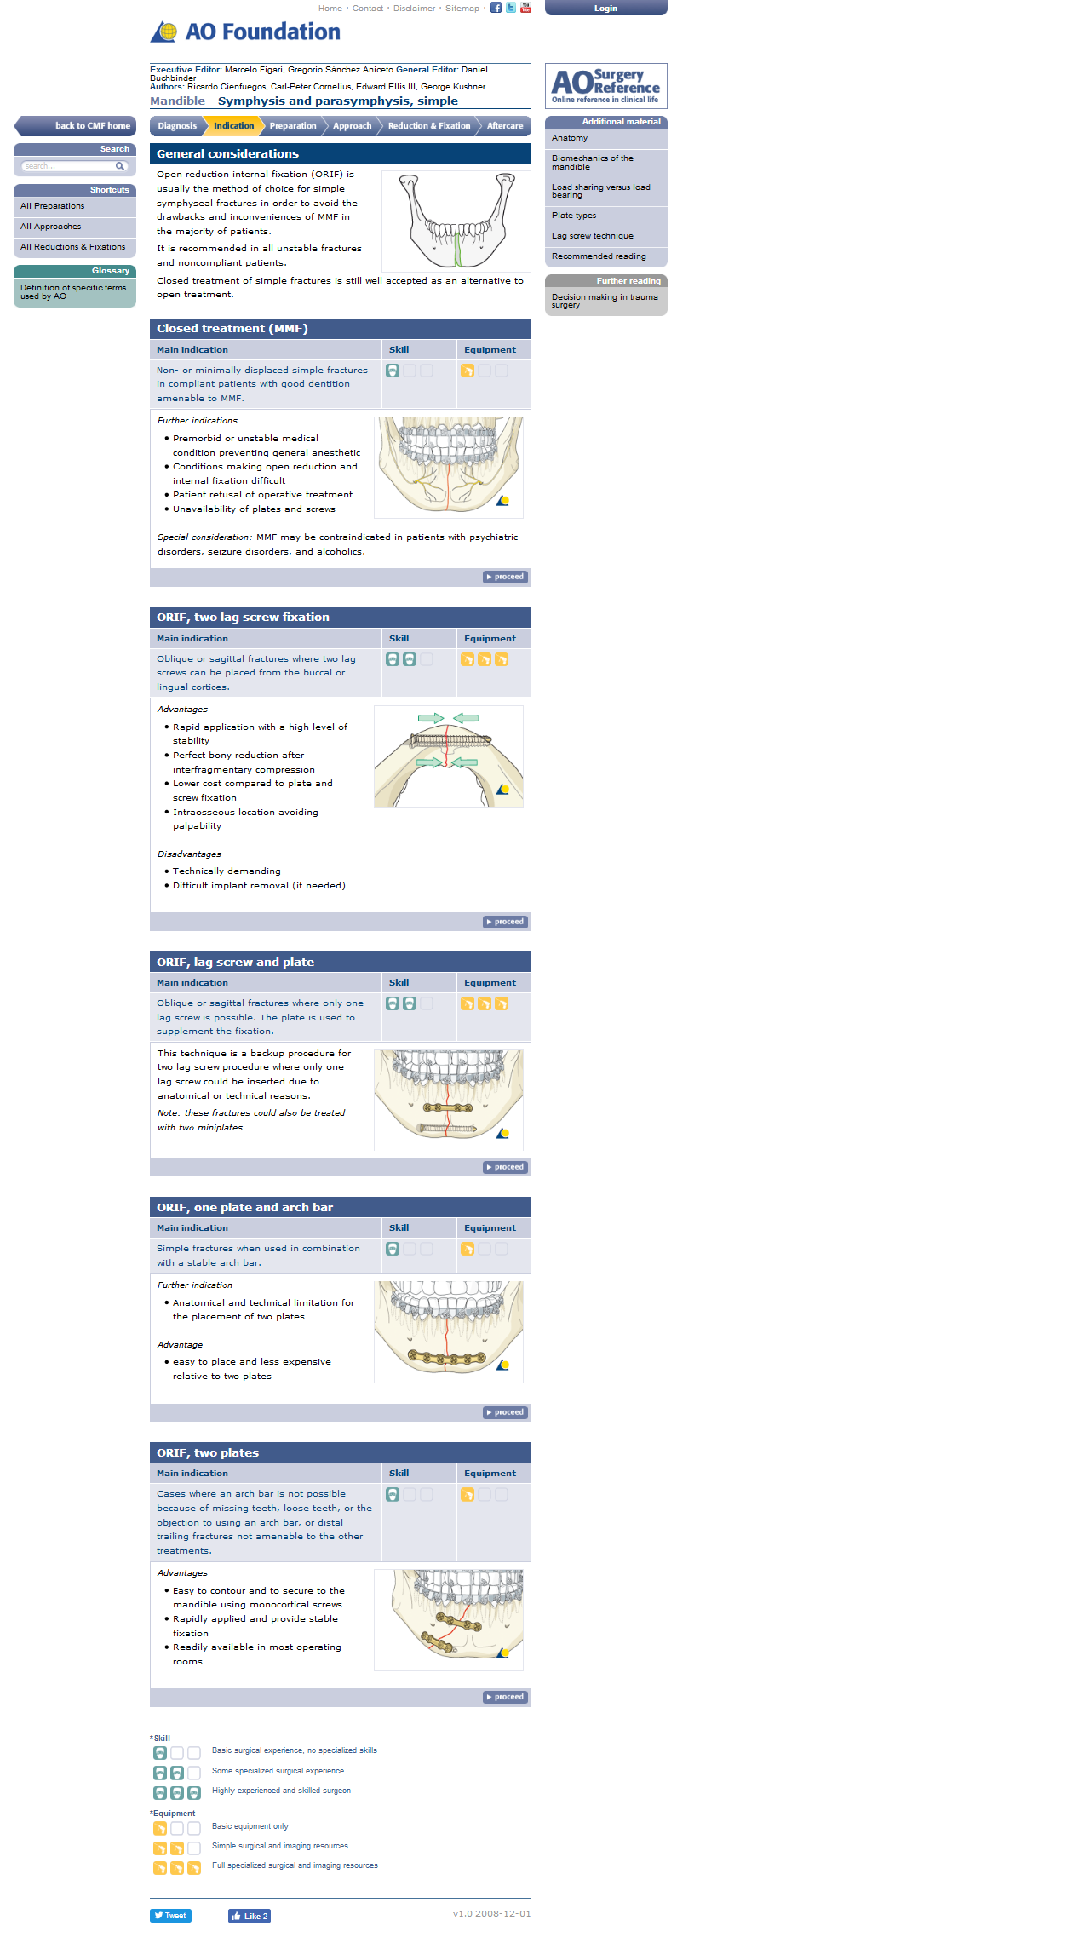

Slide 12
The patient is monitored using panorex
At 6 weeks MMF is released and fracture stability determined by manipulation.
The patient is placed on a soft diet and if the occlusion maintains for a two-week period, the arch bars may be removed.

Slide 13
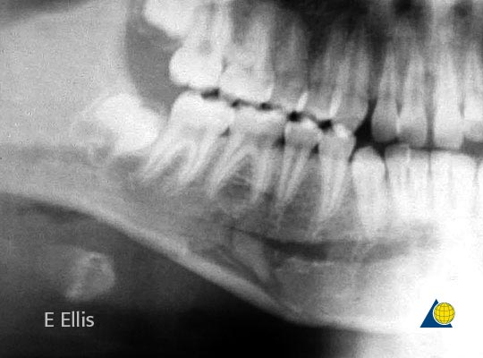

Slide 14
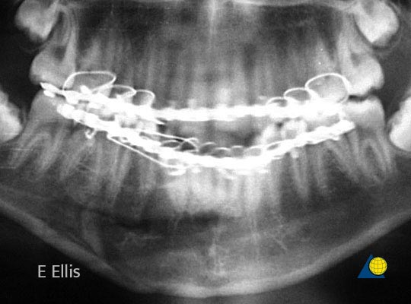

Slide 15


Slide 17
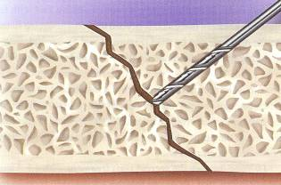
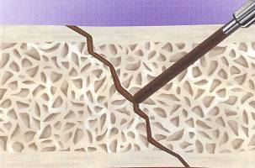
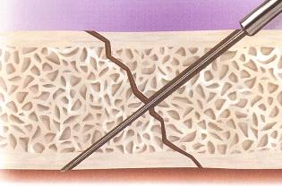
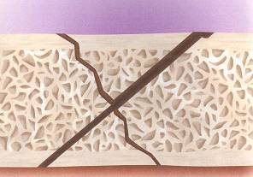
Lag Screw Technique

Slide 18
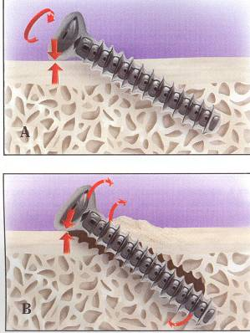
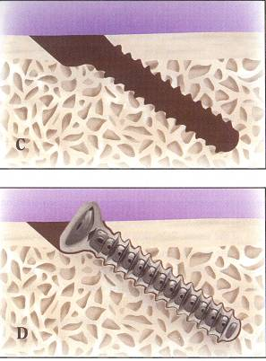
Lag Screw Technique

Slide 19
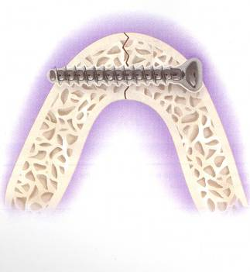
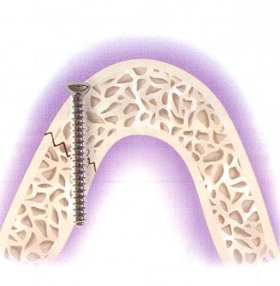
Lag Screw Technique

Slide 23
Intraoral approach to the symphysis and body
Mucosal incision
Unless contraindicated, infiltrate the area with a local anesthetic containing a vasoconstrictor.
Make an incision through the mucosa in the vestibule.
Between the canines the incision is made 10–15 mm away from the attached gingiva in a curvilinear fashion.
Posterior to the canine the incision is only 5 mm away from the attached gingiva, staying superior to the mental nerve.

Slide 24
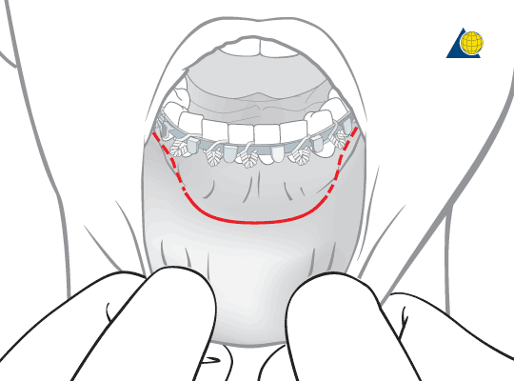

Slide 25
Surgical flap dissection
Carry the incision through the mucosal layer. Dissect a mucosal flap that retracts or is lifted (as shown) to expose the surface of the mentalis muscle

Slide 26
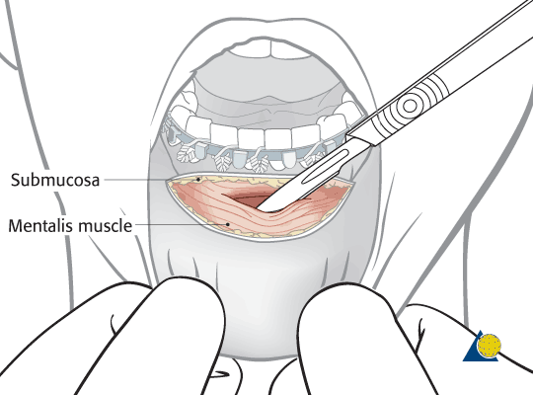

Slide 27
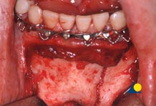
Fracture site exposure
Elevate a mucoperiosteal flap to expose the fracture.

Slide 28
Dissection of the mental nerve
In the extended intraoral approach, care must be taken to protect the trunk of the mental nerve which exits in the anterior body region.

Slide 29
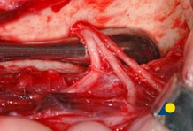

Slide 30
Plate positioning
Position the plate a few millimeters superior to the inferior border.
Because miniplate fixation is adaptation osteosynthesis and does not compress the fracture, the plate can be placed in a direction other than perpendicular to the fracture line

Slide 31
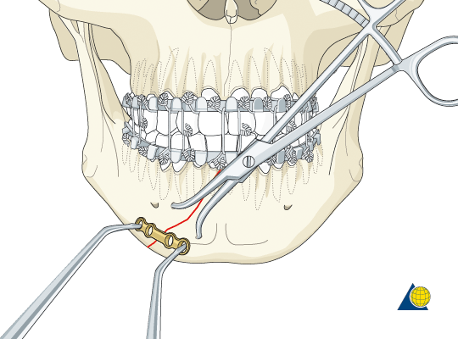

Slide 32
Application of second plate
Remove the reduction forceps.
Now place a second miniplate 2.0 below the apices of the tooth roots.
Occasionally, the plate must be positioned higher on the mandible. Great care must be taken when drilling in this area as tooth roots can be just below the cortex and can be damaged using a 6 mm drill bit with stop.

Slide 33
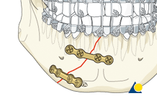

Slide 34
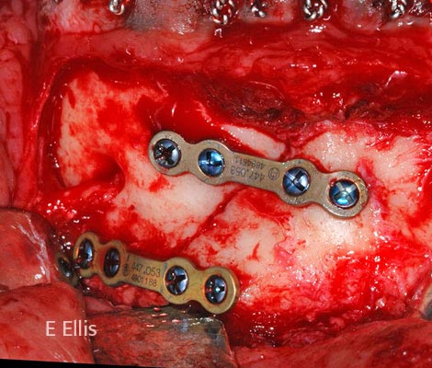

Slide 35
Body fractures

Slide 36
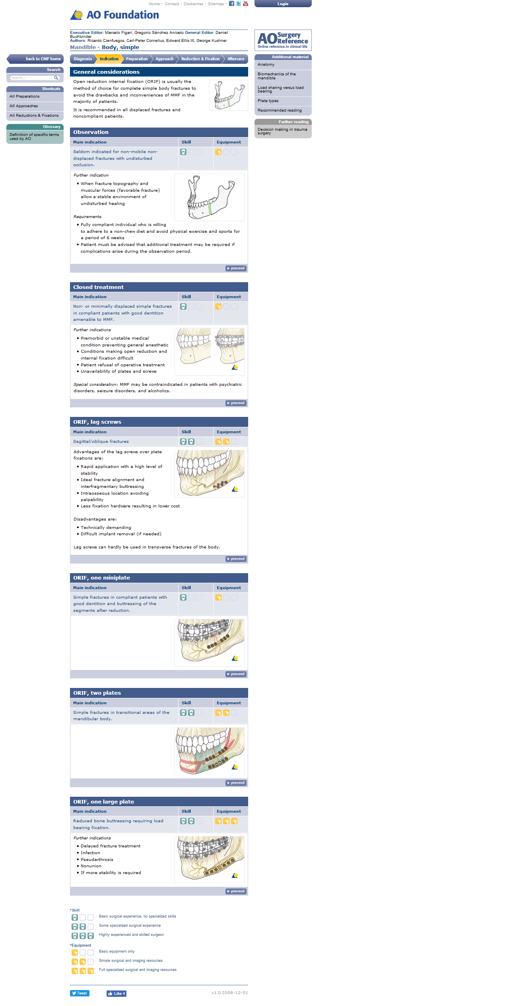

Slide 38
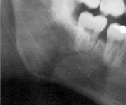

Slide 39
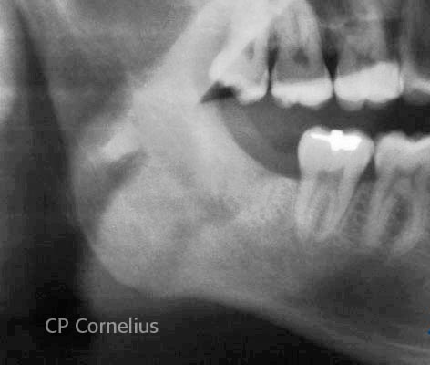

Slide 41
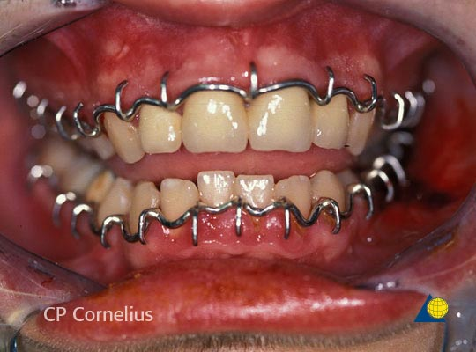
Circumdental wiring
is sometimes useful for provisional fracture reduction.

Slide 46
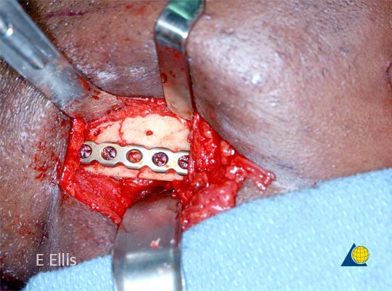

Slide 47
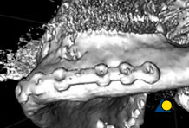

Slide 48
Angle fractures

Slide 49
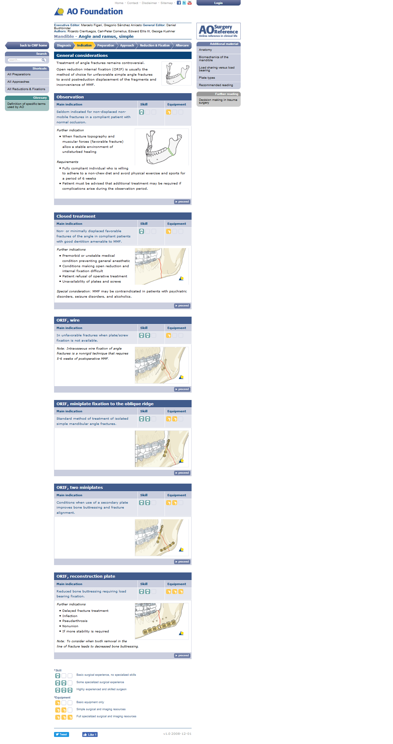

Slide 51
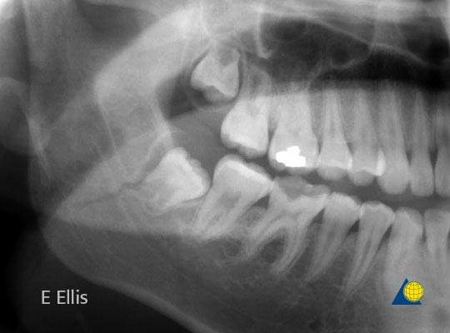

Slide 52
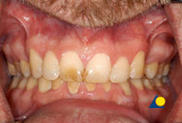
بشرط
The occlusion was normal and there was no perceptible mobility of the fracture

Slide 54
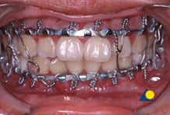

Slide 57
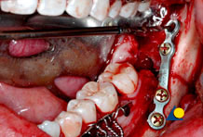

Slide 58


Slide 60
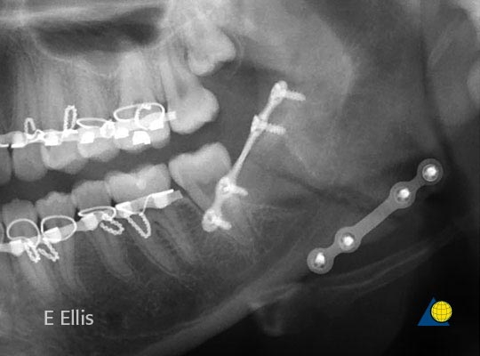

Slide 61


Slide 63
Condylar fractures

Slide 64
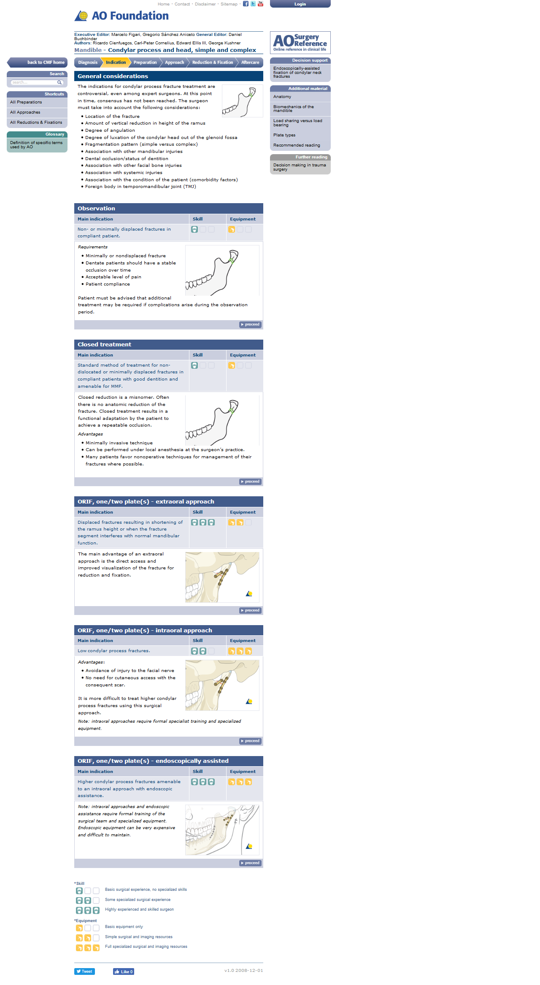

Slide 66
Observation
Diet
The patient can eat whatever is comfortable.
If solid foods cause pain, the patients will self-limit their diet to softer foods.
There is no contraindication regarding the fracture to taking solid foods.

Slide 67
Rehabilitation exercises
Patients are instructed in physical therapy maneuvers. This includes maximum jaw opening, right and left lateral excursions, and protrusive excursions of the mandible.
These exercises should be performed several times a day.

Slide 68
Follow-up
The patient is evaluated at one week to verify the occlusion and to assure adequate performance of functional rehabilitation exercises.
Typically, if the patient is doing well after 1 week, the next appointment will 2 weeks later. The necessity and frequency of future appointments will then be based on the findings at this appointment.

Slide 70
General considerations
All condylar fractures can be treated closed.
Management of condylar fractures is a controversial topic. A variety of management techniques has been described in the medical literature.

Slide 71
Closed treatment options
Closed treatment for condylar fractures may involve the following:
A period of MMF
Functional therapy (immediate function with elastics)
A combination of the above

Slide 73
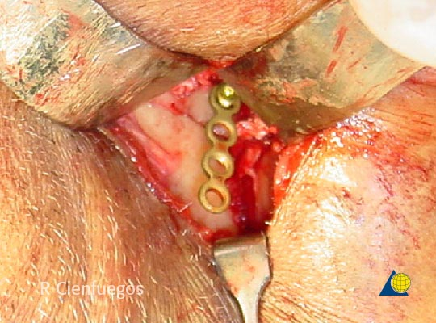

Slide 74
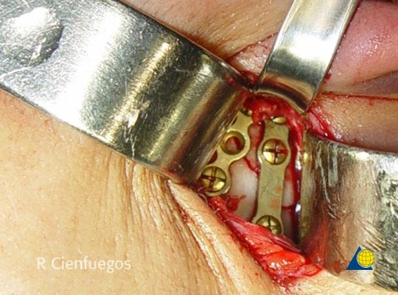
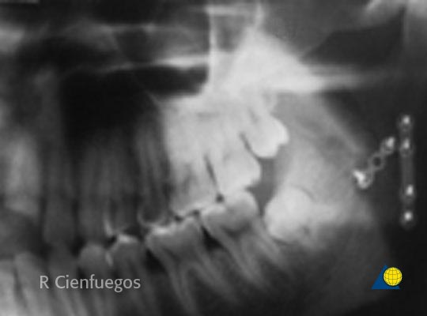

Slide 76
The last message
Mandible is the only mobile segment in face that bears the load of masticatory forces
Fracture mandible is one of the most common presentation in ER
Good evaluation of the patient is a vital item in management
Not all mandiblar fractures are operative
Conservative treatment is an art that only done by the expert in that spspeciality

Slide 77
الحمد لله الذى بنعمته تتم الصالحات

